Slide 1
Secure Data Hiding in Images Using Steganography
CAPSTONE PROJECT
Presented By: YERRAGUNTLA MADHU SUDHAN
Student Name : YERRAGUNTLA MADHU SUDHAN
College Name & Department : GITAM University, Bangalore - Computer Science & Engineering (Cyber Security)

Slide 2
OUTLINE
Problem Statement
Technology used
Wow factor
End users
Result
Conclusion
Git-hub Link

Slide 3
Problem Statement
Problem Statement With the rise of cyber threats, securely transmitting sensitive information has become a challenge. Traditional encryption methods are prone to detection, leading to potential security breaches. Steganography provides a solution by embedding messages in digital media, making them undetectable to unauthorized parties.

Slide 4
Technology used
Programming Language: Python
Libraries Used: OpenCV, NumPy, PIL (Pillow)
Algorithm: Least Significant Bit (LSB) Steganography
Platform: Windows/Linux

Slide 5
Wow factors
Enhanced Security: Data is hidden within images, making it undetectable.
Passcode Protection: Decryption requires a user-defined passcode.
Minimal Data Alteration: Uses the LSB technique to ensure the image remains visually unchanged.
Real-time Encryption & Decryption: Users can encrypt and retrieve hidden messages instantly.

Slide 6
End users
Cybersecurity Professionals: Secure communication and information hiding.
Government & Defense: Confidential data transfer.
Journalists & Activists: Safeguarding sensitive information.
General Users: Protecting personal data.

Slide 7
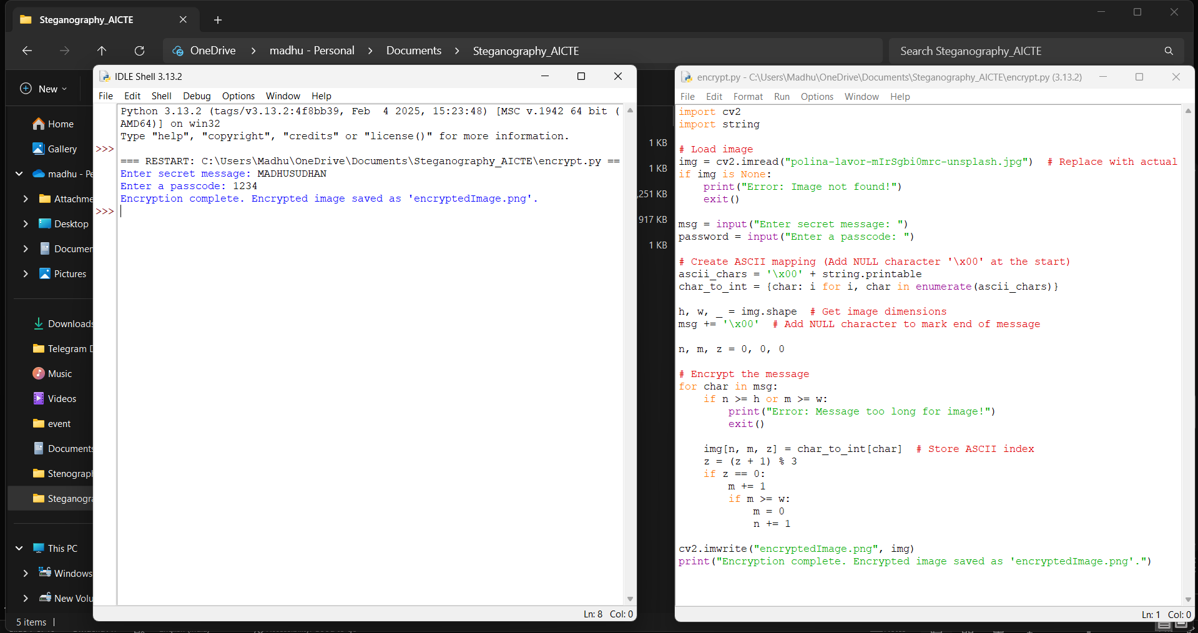
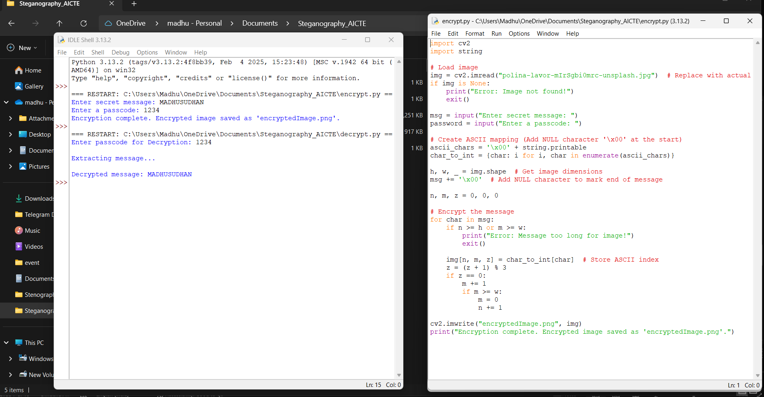
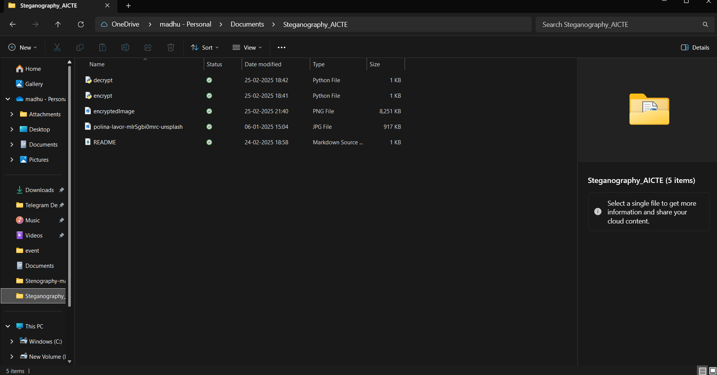
Results

Slide 8
Conclusion
Conclusion This project demonstrates how steganography can be used to securely hide sensitive data within images. The use of Python and the LSB algorithm ensures efficient encoding while maintaining image integrity. With further enhancements, this technology can be expanded for real-world secure communications.

Slide 9
GitHub Link
https://github.com/madhusudhan0910/Steganography_AICTE.git

Slide 10
THANK YOU

